Slide 1

Agile and Waterfall
By Anyssa Livingston

Slide 2
Agile Roles
Product Owner
Responsible for prioritizing the backlog, user stories and ensuring alignment with objectives
Scrum Master
Facilitator of the Scrum process; ensuring the team follows Agile principles, removes impediments, and fosters collaboration. Organizes and leads daily-stand up meetings, sprint planning and review sessions.
Development team
Cross-functional group responsible for implementing user stories and delivering a potentially shippable product increment in each sprint
Stakeholders
Individuals or groups who have an interest in the projects outcome, providing feedback and sometimes attending Sprint Review meetings to see the progress and make suggestions

Slide 3
Agile Phases
Planning
Involves creating a product backlog, planning the work for the next Sprint, and setting priorities
Execution
The development team during the Sprint works on the tasks from the backlog, aiming to create a potentially shippable product increment
Review
Is done at the end of the Sprint, held to demonstrate the completed work to stakeholders and gather feedback
Retrospective
After the review, the team conducts a retrospective to reflect on what could be improved in the next sprint and what went well

Slide 4
Waterfall Phases
Requirements
Project specifications and stakeholder needs will be collected upfront
Design
Technical blueprints are created to map out how to build the specific features required
Implementation
The actual product begins with the building process
Testing
Verify everything for the product is working correctly
Deployment
The finished product is released and ready to be shipped

Slide 5

Waterfall Model
In a waterfall development approach, it is more rigid. The process is linear and each phase is done in order. If there is an issue in one phase, it can fall into further phases which then causes delays and increased costs. An example would be if there is a misunderstanding in the initial requirements phase, it might not be discovered until the test phase. Trying to fix this issue late in the project can be costly and time-consuming in a Waterfall approach, causing delays.

Slide 6
Waterfall or Agile Approach
Waterfall Approach
Agile Approach
Suits well-defined, straightforward projects
Typically has less customer involvement until the end
Less flexible for changes
May not reveal risks until later stages
More suitable when resources are limited and detailed planning is crucial
Better for complex or evolving projects
Encourages regular customer feedback
Highly adaptable to changing requirements
Allows to identify and mitigate risks early

Slide 7
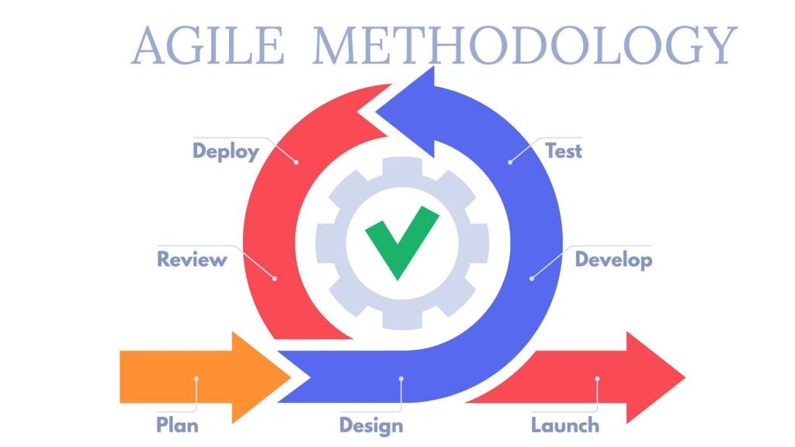
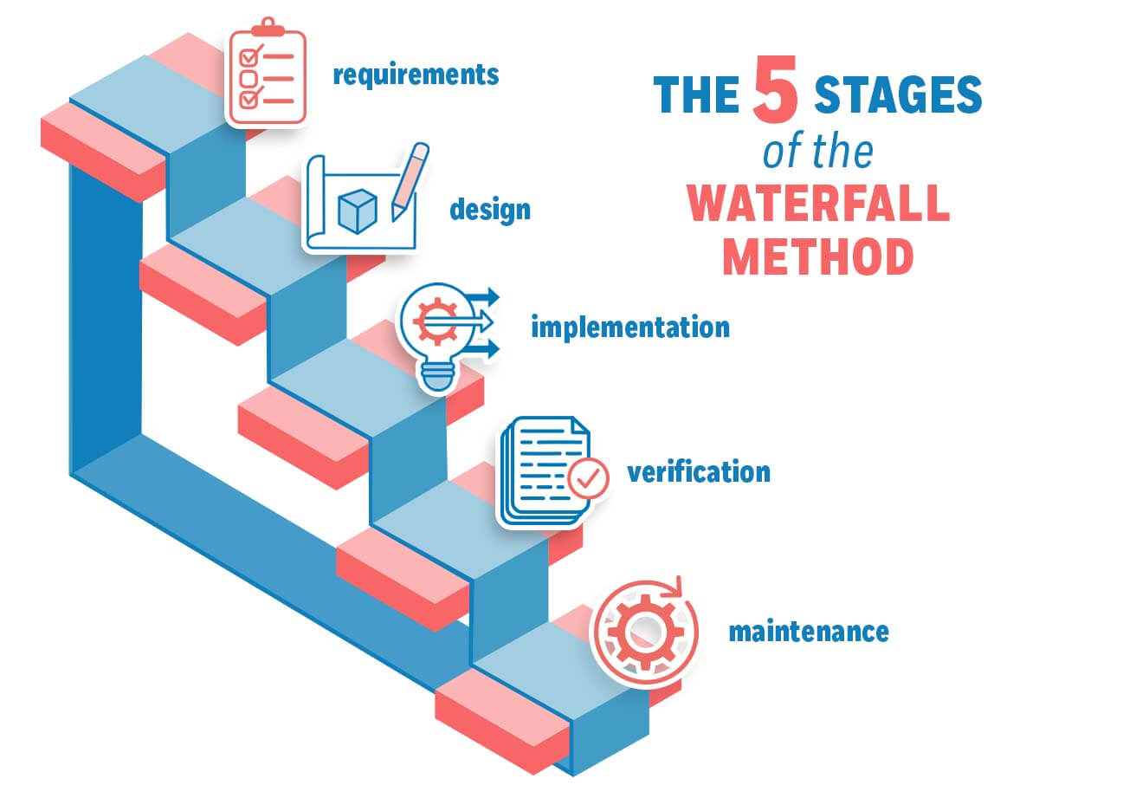
Phases are flexible, broken into small cycles to continuously improve.
Phases are done linearly in order, must be completed before the next begins.

Slide 8
Places Which Are Ideally For
Waterfall examples
Agile examples
Industries and business types at which compliance, safety, and precision are critical like:
Healthcare
Aerospace
Government
Manufacturing
Complex and dynamic projects in certain industries such as:
Marketing
Construction
Software Development
Media and entertainment
Finance

Slide 9
Info to Include in the Approaches
Secure coding
User needs
Summary
For the execution phase in a software development lifecycle, it is always important to remember to have secure coding practices and security be implemented in coding.
Implement user needs into the program by gathering information, prioritizing their needs and analyzing data. This clarifies what users want which helps the development team understand the values of features.
Agile methodologies, user involvements, and incremental development help approach developing programs.

Slide 10
Sources
Zhezherau, A. (2022, November 16). The Agile Software Development Life Cycle: Wrike Agile Guide. Versatile & Robust Project Management Software. https://www.wrike.com/agile-guide/agile-development-life-cycle/
Atlassian, M. (2025). What is Scrum? [+ how to start]. https://www.atlassian.com/agile/scrum#:~:text=Scrum%20is%20an%20agile%20project,values%2C%20principles%2C%20and%20practices.
Overeem, B. (2016, April 15). Characteristics of a great scrum team. InfoQ. https://www.infoq.com/articles/great-scrum-team/
Cobb, C. G. (2023). The Project Manager’s Guide to Mastering Agile: Principles and practices for an adaptive approach. John Wiley & Sons, Inc.
Gofishdigital. (2024, July 31). Scrum vs. waterfall: Complete guide. Knack. https://www.knack.com/blog/scrum-vs-waterfall/
Kazinik, B. (2026, March 8). Scrum vs waterfall: Choosing the right methodology in 2026. monday.com Blog. https://monday.com/blog/rnd/scrum-vs-waterfall/

